Slide 1


C++ Projects - Sets

Slide 2
Content
Our team.
How we did the project?
The idea of the project.
Future plans.

Slide 3
Our Team
Hristo Hristov (Scrum Trainer)
Plamen Kostov (Developer C++)
Plamen Petkov (Developer C++)
Ilian Yanev (Developer Frontend)
Kristian Lalev (Code Checker)

Slide 4


The idea of the project

Slide 5




How we did the project

Slide 6

Future plans

Slide 7
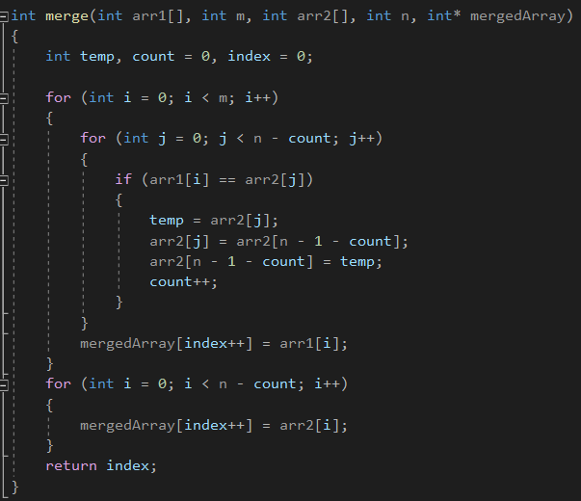
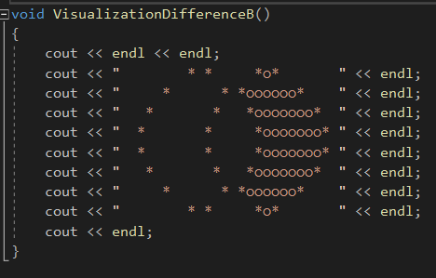
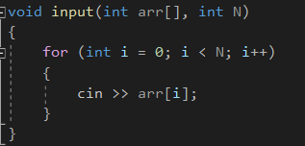
Parts of the code

Slide 8
